Slide 1

An Investigation Into Motor Vehicle Crashes
TEAM 5
jimmy dela cRuz
Andrea Kwong
Charlie Lee
Vijaya Tatineni

Slide 2
MOTIVATION
WHY
The discussion of the state of our national infrastructure is an important and relevant issue that has economic implications. With U.S. vehicle sales at $17.55 million² in 2016, we are driving more than before.¹ With more vehicles on the road, we have also seen over 37,000 people killed in vehicle crashes³ in 2016. Did poor road infrastructure contribute to these fatalities? Have our roads become more dangerous and do they affect our public safety? Or are there other factors at play that correlate with these crashes? We hoped to find some answers with the intention of understanding the nature of motor vehicle accidents.
Notes:
Federal Highway Administration reported that 3.2 Trillion- fifth straight year of increased mileage on public roads throughout the nation.This was the seventh straight year of year over year sales gains. 6.8% increase from 2015.Safety? --->The discussion the state of our national infrastructure is an important and relevant issue that has economic implications.

Slide 3
Overview
OBJECTIVE:
Investigate U.S. motor vehicle accidents in 2016 to better understand the types and causes of these accidents.
HYPOTHESIS :
Poor Lighting conditions causes more accidents
Bad Weather causes more accidents
Bad road Infrastructure causes more accidents
More accidents occur on weekends/holidays compared to weekdays
Impoverished counties have more accidents

Slide 4
SUMMARY OF FINDINGS
Unfortunately, the data that we used did not provide sufficient information to delve deeper into the relationship between poor roads and motor vehicle accidents.
However, we were able to look into other aspects of vehicle crashes and now have a better understanding of how weather, lighting conditions, and the time of day contribute to vehicle crashes.
We also analyzed the first damaging event or injury that occurred right after the crash and looked into demographic data of those that died or were injured in crashes.

Slide 5
DATA
PRIMARY SOURCE
The National Highway Traffic & Safety Administration (NTHSA) (https://www.nhtsa.gov/) under the Department of Transportation documents annual fatality data on motor vehicle crashes for all 50 states. Information on the accident, the vehicle, the person(s) involved are provided. We looked at 2016 data for our analysis.
Notes:
Initially we looked at data.gov but found vehicle crash data only for certain states.

Slide 6
QUESTIONS
LIGHTING CONDITIONS (Jimmy) - What causes of accidents from police report(CF) and Harmful Events were associated with Lighting? Is there an association between the number of fatalities and lighting? What about drunk driving and lighting?
TIME OF DAY (Andrea) – What are differences between holidays/weekend vs weekday crashes in relation to the number of fatalities, whether drunk driving was involved, the time of hour and type of harmful events. Which states and counties had the most crashes?
WEATHER (Charlie) – Is there a correlation between weather and the manner of collision? Does bad weather lead to an increased number of accidents?
HARMFUL EVENTS (Vijaya) – What types of crash occur more frequently, for what age groups? How does this compare to 2015 data?

Slide 7
DATA CLEANING
Downloaded relevant csv files for 2016 and 2015 from NHTSA website. (accident and person files)
Used the reference, “Fatality Analysis Reporting System (FARS) Analytical User’s Manual” to understand the columns and the codes associated with each data element.
Created separate csv files for the relevant fields. (codes and values)
Read csv files into dataframes and mapped the values from the codes.
For City and County columns, downloaded a separate XLS file from GSA.gov, created a unique index which was a combination of the state, county, and city and mapped the city and county names.
We deleted duplicates and filled in null spaces.
Created a csv file from cleaned dataframe, which was used for exploration and analysis
Notes:
The csv files had alot of columns with codes, that didn’t make any sesse just by looking at it.
So we had to go through a manual that was provided by FARS to understand the columns and the data associated with each of those columns.
For each of these columns FARS manual had codes and the description of those codes.
Then we have listed out the columns that we thought we would need to analyze the data.
We have then crated csv files with codes and respective values for each of these columns
Read all the csv files into dataframes using pandas
Then for each column in our main dataframe, we have replaced the codes with corresponding descriptions using the map function
accidents_df['CF1'] = accidents_df['CF1'].map(cf.set_index('Code')['Attribute'])
We also wanted to explore the data at county level, so we have created a unique index state_city_county which is a combination of 3 different columns

Slide 8

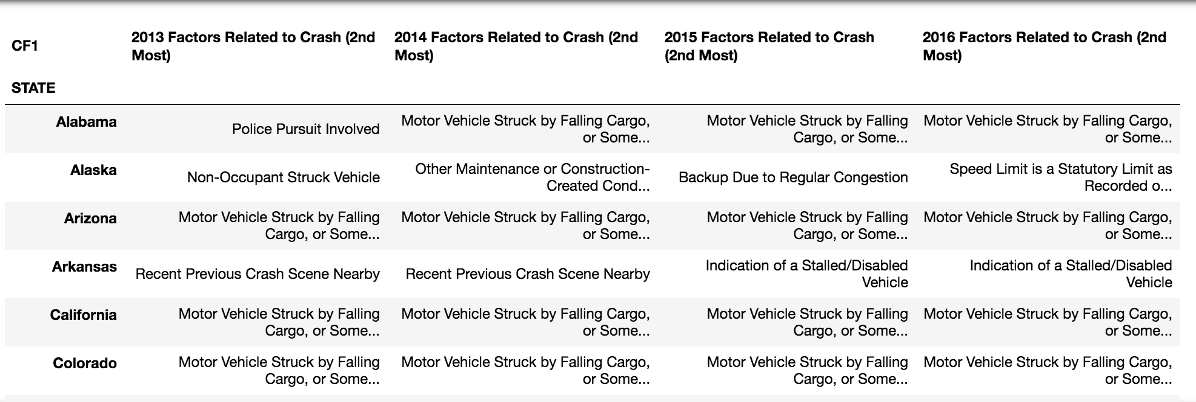
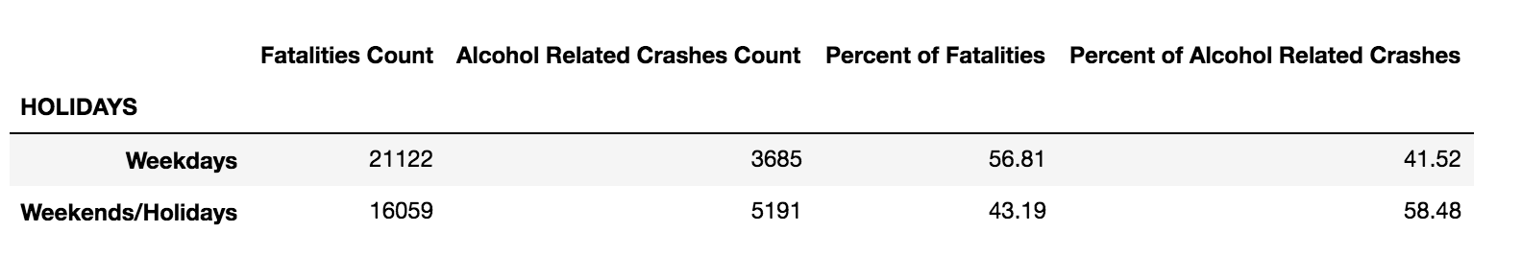
DATA EXPLORATION
Lack of relevant data
One of the columns included factors related to the crash which included infrastructure as reported by the investigating officer. However, over 90% of the data reported no factors related to the crash.
Pivot to another interesting variable
General to granular data
Notes:
One of the interesting things we wanted to look at was if there was a correlation between road infrastructure and # of accidents,
Few columns in the csv file had factors related to crash which included infrastructuural issues reported by investigating officer. However, over 90% of the data reported no factors related to the crash.
Instead, we looked into the second most reported factor for 2016. Then, explored this over a period of four years (2013-2016).
Finally, we further looked at this data by state.

Slide 9

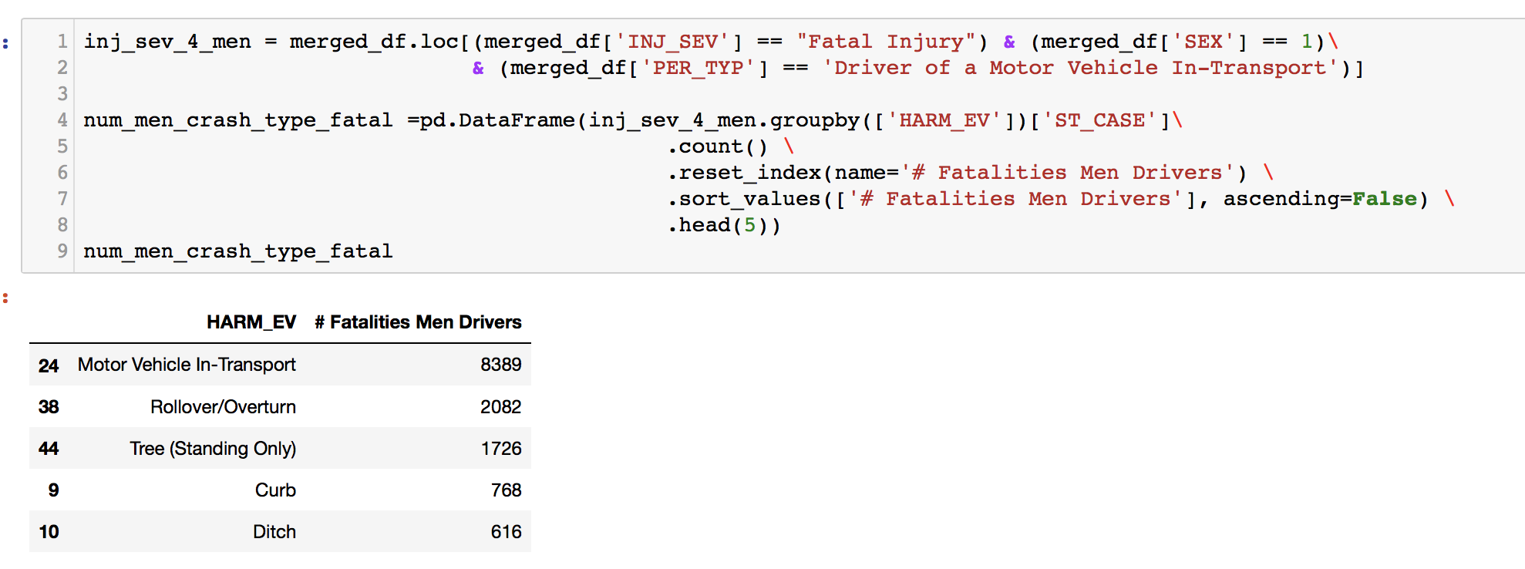



DATA EXPLORATION
Used bins to categorize persons by age
Merging different dataframes
Used loc to subset/slice the data.
Notes:
Used bins to categorize persons by age
Merging different dataframes
To get the number of fatalities, for each accident type, we merged the columns of accidents dataframe with persons dataframe.
Used loc to subset/slice the data.
To get the number of men that who were driving the vehicle and suffered fatal injuries. And then used groupby to list the most common harmful events

Slide 10
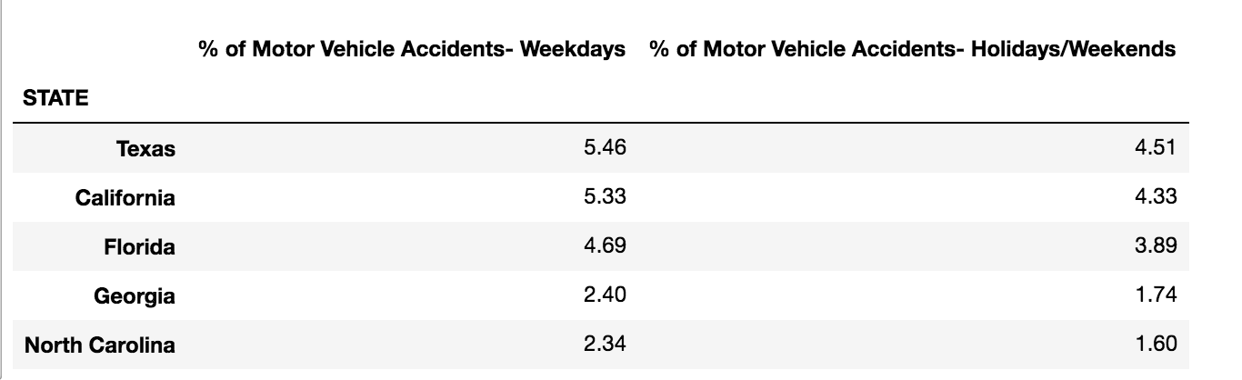
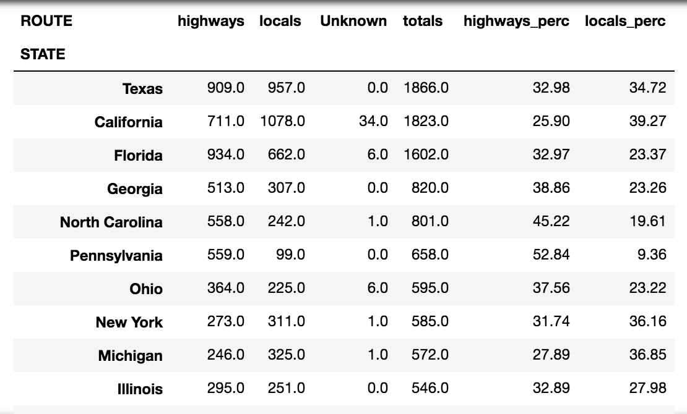
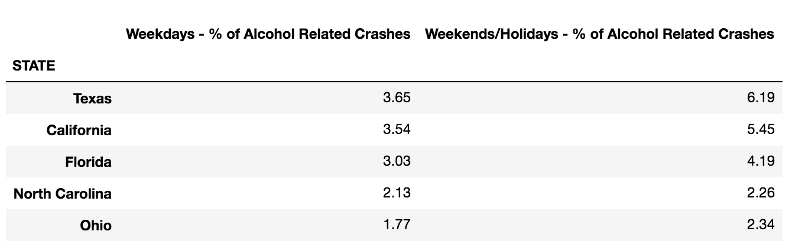
DATA ANALYSIS
% of CRASHES by DAY & STATE
% of CRASHES by ROUTE & STATE
% of ALCOHOL RELATED CRASHES by DAY & STATE
Notes:
Top 5 Highly populated sates as per 2016 data were:
California, Texas, Florida, New York, Illinios
and of these states, Texas, CA, FL also topped the list of crashes
Also for each of these states, the % of motor vehicle accidents were higher over weekdays when compared to weekends
While the % alcohol related crashes were higher over weekends when compared to weekdays

Slide 11
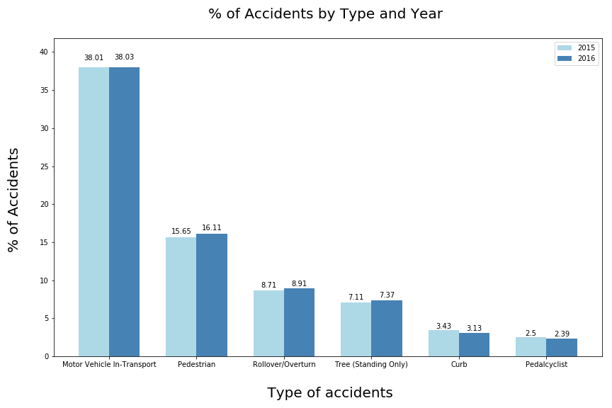
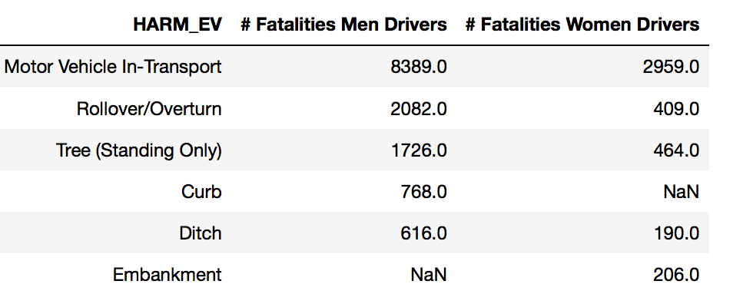
CRASH TYPES
Almost 38% of the accidents resulted in damaging or injuring other motor vehicles that are in motion
Next highest involved injuring a pedestrian
In most of the cases the % of accidents increased in 2016 when compared to 2015

Slide 12
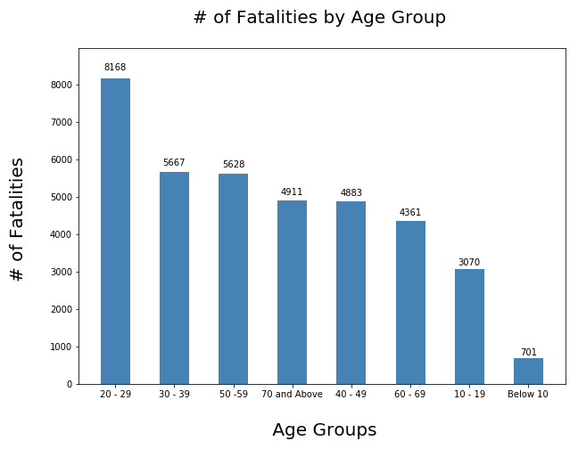
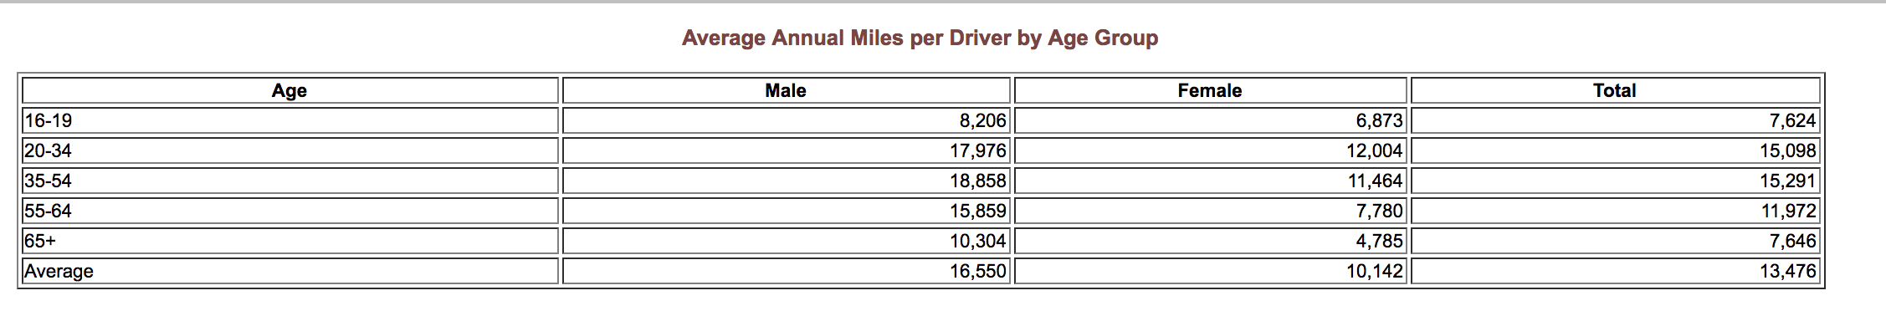
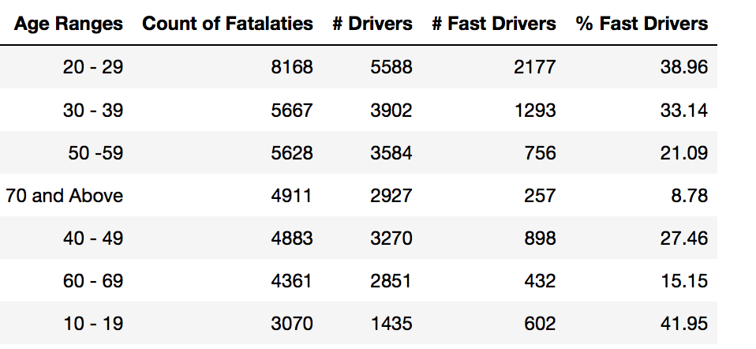
FATALITIES BY AGE
# Fatalities & # Drivers by Age:
Age Groups : 20 -29 clearly topped the list.
Followed by 30 -39 and 50 -59
% of Fast Drivers:
Age Groups : 10 -19 and 20 – 29 clearly topped the list. Followed by 30 -39
Notes:
https://www.fhwa.dot.gov/ohim/onh00/bar8.htm
Although according to federal highway administration, the Avg number of miles travelled per person for ages between 20 to 54, is about the same
Younger generations are driving at higher speeds when compared to older age groups.

Slide 13
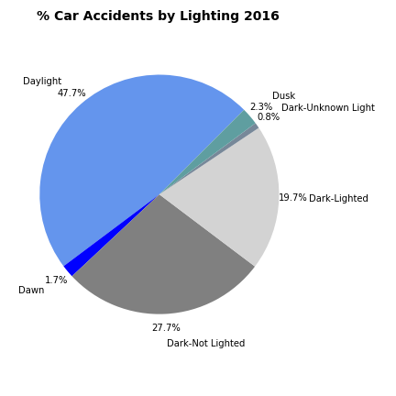
LIGHTING CONDITIONS
Although more people drive in daylight than in the dark, the percentages of accidents are similar.
About 50% more accidents occur during dark–not lighted conditions versus dark–lighted conditions. It is much safer to drive in the light.

Slide 14
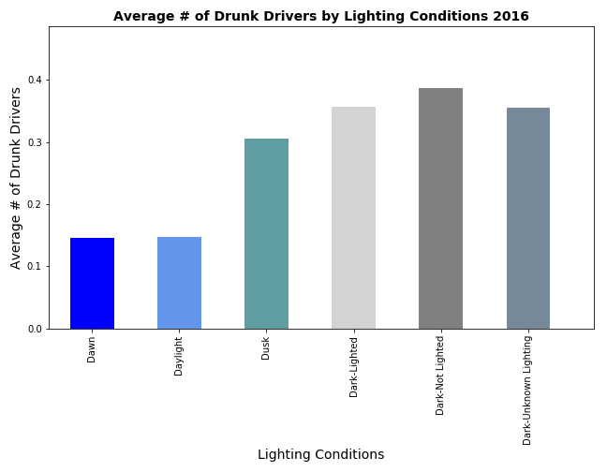
LIGHTING CONDITIONS
The average number of drunk drivers involved in accidents in dark conditions are more than twice the amount in daylight. Drivers should be more careful when driving at night as there is a higher chance of being involved in accidents with drunk drivers.

Slide 15
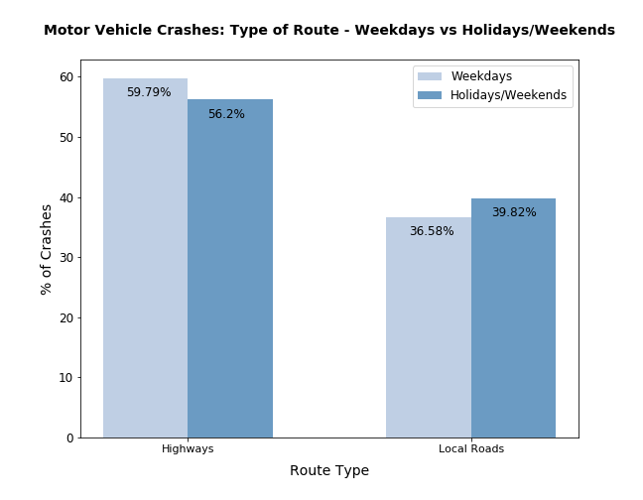
WEEKENDS/HOLIDAYS vs. WEEKDAYS
For both holidays/weekends and weekdays, highways accounted for almost 60% of vehicle crashes.
Local roads accounted for almost 40% of accidents.
Notes:
.

Slide 16
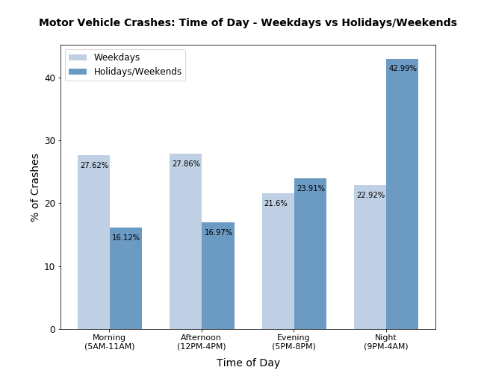
WEEKENDS/HOLIDAYS vs. WEEKDAYS
On weekdays, 56% of vehicle crashes occurred either in the Morning or Afternoon. These times are commuting hours.
43% of vehicle crashes occurred during the Night on holidays/weekends.

Slide 17
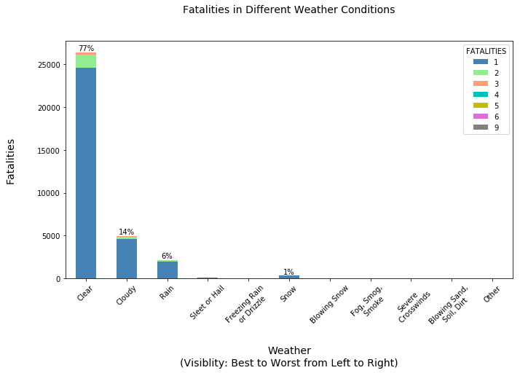
WEATHER
The number of fatalities in good weather is dramatically greater than in bad weather.
People tend to be more careful when driving in bad weather.
People generally drive more when the weather is good.

Slide 18
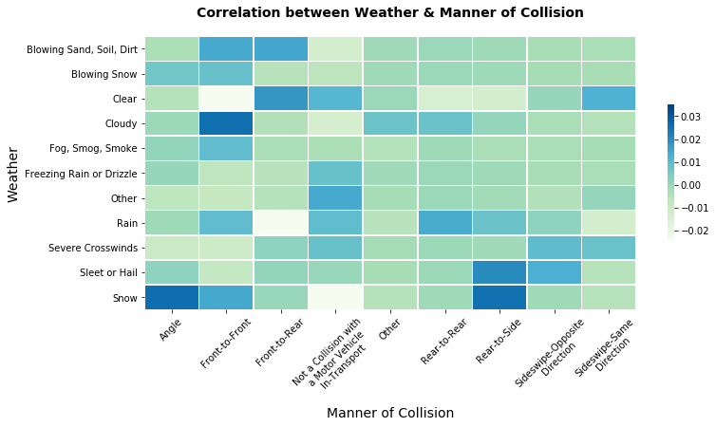
WEATHER
Highest Correlation
Clear: Front-to-Rear
Cloudy: Front-to-Front
Sleet/Hail: Rear-to-Side
Snow: Angle &
Rear-to-Side
Cars can easily skid on icy roads.

Slide 19

FINDINGS
Poor Lighting conditions causes more accidents – Turned out to be true!!
Bad Weather causes more accidents – Not necessarily true. More fatalities during clear weather
Bad road Infrastructure causes more accidents – Not adequate data to support this hypothesis
More accidents occur on weekends/holidays compared to weekdays – Not true! Looks like more accidents occur on Weekdays on Highways!!
Younger generations tend to drive at exceeding speed limits, which could lead to higher number of accidents

Slide 20
CONCLUSIONS
Concerned authorities should invest more in better lighting mechanisms to save lives
More stringent policies on Chained tires on Snowy days
Build better monitoring systems for speed limit violations
Better laws/signs for the safety of pedestrians
Research further ??
Going into more granular levels like county/state level information
Using the Lat/Lng coordinates to plot the fatalities on a Map
Notes:
Radar enforced devices to monitor the vehicles going over the posted speed limits

Slide 21


